Slide 1
Final project
PAULINA LOPEZ SEPULVEDA

Slide 2
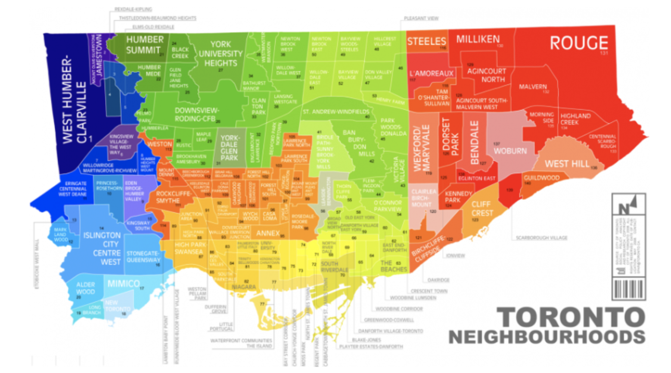
Since there are lots of different shops in Toronti we will try to detect the best location in North York. We are also particularly interested in areas with not activities in vicinity. We would also prefer locations as close to city center as possible, assuming that first two conditions are met. We will use our data science powers to generate a few most promissing neighborhoods based on this criteria. Advantages of each area will then be clearly expressed so that best possible final location can be chosen by stakeholders.

Slide 3
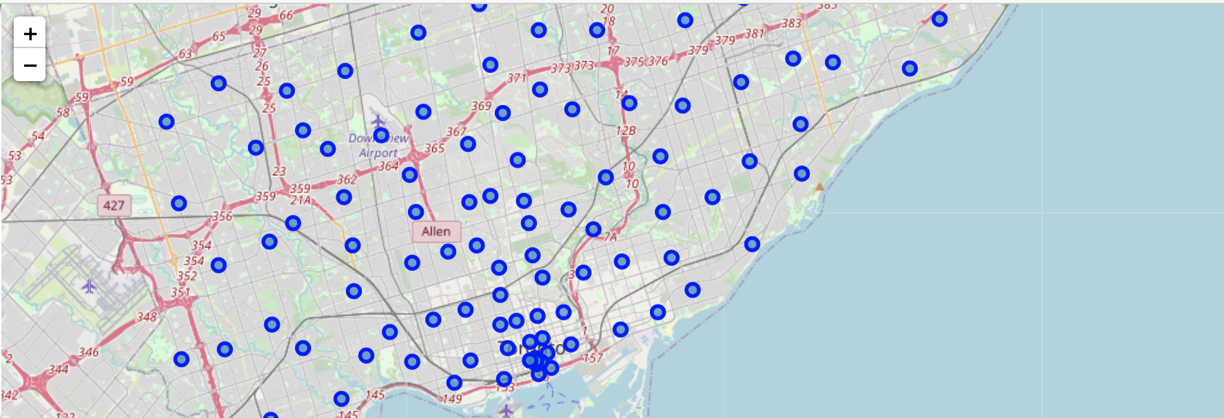
Based on definition of our problem, factors that will influence our decission are:
number of existing shops in the neighborhood (any type)
number of and distance to other shops in the neighborhood, if any
distance of neighborhood from city center
We decided to use regularly spaced grid of locations, centered around city center, to define our neighborhoods.
Following data sources will be needed to extract/generate the required information:
centers of candidate areas will be generated algorithmically and approximate addresses of centers of those areas will be obtained using Google Maps API reverse geocoding
number of store and their type and location in every neighborhood will be obtained using Foursquare API
coordinate of Toronto center will be obtained using Google Maps API geocoding of well known North York location.
 | Address | Latitude | Longitude | X | Y | Distance from center
0 | 13 Coldwater Rd, North York, ON M3B 2M1 | 43.754269 | -79.360317 | -5.294805e+06 | 1.050305e+07 | 5992.495307
1 | 1939 Leslie St, North York, ON M3B 2M3 | 43.758001 | -79.360883 | -5.294205e+06 | 1.050305e+07 | 5840.376700
2 | 31 Laurie Shepway, North York, ON M2J 1X6 | 43.761734 | -79.361449 | -5.293605e+06 | 1.050305e+07 | 5747.173218
3 | &, Leslie Street, ON-401, Toronto, ON M2L | 43.765467 | -79.362014 | -5.293005e+06 | 1.050305e+07 | 5715.767665
4 | 4001 Leslie St, North York, ON M2K 1E1 | 43.769200 | -79.362580 | -5.292405e+06 | 1.050305e+07 | 5747.173218
5 | 86 Cheryl Shepway, North York, ON M2J 4R6 | 43.772933 | -79.363146 | -5.291805e+06 | 1.050305e+07 | 5840.376700
6 | 19 Kingland Crescent, North York, ON M2J 2B8 | 43.776667 | -79.363713 | -5.291205e+06 | 1.050305e+07 | 5992.495307
7 | 56 Barrydale Crescent, North York, ON M3B 3E2 | 43.748315 | -79.363927 | -5.295705e+06 | 1.050357e+07 | 5855.766389
8 | 98 Abbeywood Trail, North York, ON M3B 3B5 | 43.752047 | -79.364493 | -5.295105e+06 | 1.050357e+07 | 5604.462508
9 | 15 Magpie Crescent, North York, ON M2L 2E6 | 43.755780 | -79.365059 | -5.294505e+06 | 1.050357e+07 | 540

Slide 4
METHODOLOGY
In this project we will direct our efforts on detecting areas of North York that have low store density. We will limit our analysis to area ~6km around city center.
In first step we have collected the required data: location and type (category) of every store within 6km from North York center. We have also identified different stores (according to Foursquare categorization).
Second step in our analysis will be calculation and exploration of 'store density' across different areas of Toronto - we will use heatmaps to identify a few promising areas close to center with low number of store in general and focus our attention on those areas.
In third and final step we will focus on most promising areas and within those create clusters of locations that meet some basic requirements established in discussion with stakeholders: we will take into consideration locations with no more than two store in radius of 500 meters. We will present map of all such locations but also create clusters (using k-means clustering) of those locations to identify general zones / neighborhoods / addresses which should be a starting point for final 'street level' exploration and search for optimal venue location by stakeholders.

Slide 5
ANALYSIS
Reorganize the categories, for then, realized k-means studio
 |  | name | id | categories | lat
4 | Loblaws | 4ae257cff964a520758d21e3 | Grocery Store | 43.768722 | -79.412101
6 | Starbucks | 4aedfeadf964a52005d121e3 | Coffee Shop | 43.768353 | -79.413046
8 | The Alley | 5ac6b2e2efa82a057cbd0c49 | Bubble Tea Shop | 43.776359 | -79.414384
12 | Mel Lastman Square | 4bc876028b7c9c74162038cf | Plaza | 43.767701 | -79.412975
13 | Metro | 4af2473cf964a52014e721e3 | Supermarket | 43.774171 | -79.413432

Slide 6
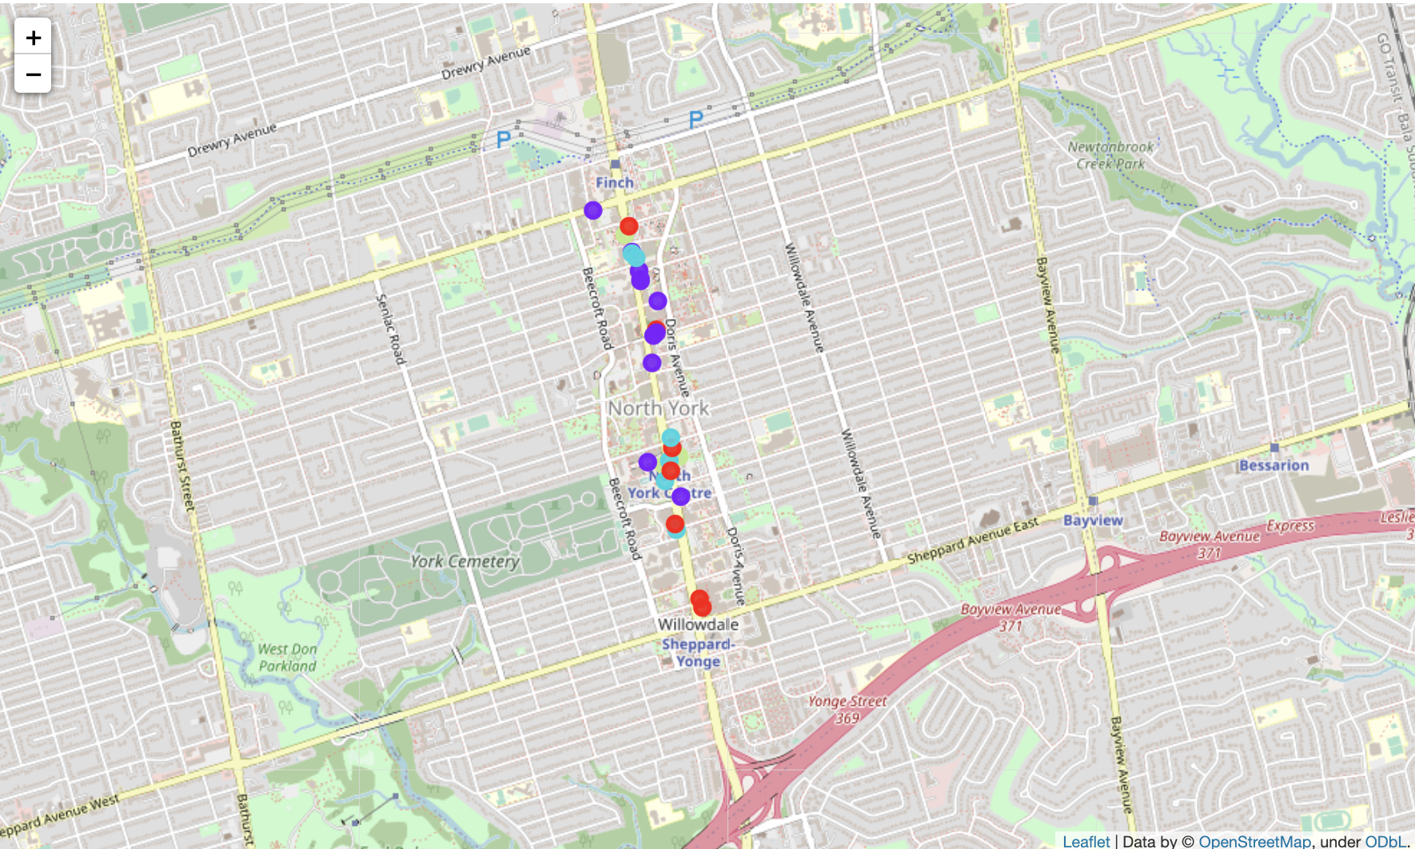
 | name | id | categories | lat | lng | total likes | total likes_cat | categories_new | label
4 | Loblaws | 4ae257cff964a520758d21e3 | Grocery Store | 43.768722 | -79.412101 | 90 | great | Groceries | 3
6 | Starbucks | 4aedfeadf964a52005d121e3 | Coffee Shop | 43.768353 | -79.413046 | 85 | great | Food_store | 3
8 | The Alley | 5ac6b2e2efa82a057cbd0c49 | Bubble Tea Shop | 43.776359 | -79.414384 | 12 | poor | Food_store | 1
12 | Mel Lastman Square | 4bc876028b7c9c74162038cf | Plaza | 43.767701 | -79.412975 | 36 | below avg | Plaza | 2
13 | Metro | 4af2473cf964a52014e721e3 | Supermarket | 43.774171 | -79.413432 | 56 | avg avg | Groceries | 0

Slide 7
CONCLUSION
Our analysis shows that although there is a lot of number of store in North of York. Highest concentration of store was detected in one of the principal avenue of the city, so we focused our attention this area, also becaus eir near to big place like the Cementery and a lot of parks.
After directing our attention to this more narrow area of interest we first created a dense grid of location candidates (spaced 100m appart); those locations were then filtered so that those with more than two store in radius of 500m.
Those location candidates were then clustered to create zones of interest which contain greatest number of location candidates. Addresses of centers of those zones were also generated using reverse geocoding to be used as markers/starting points for more detailed local analysis based on other factors.
Purpose of this project was to identify North York areas close to center with low number of stores(particularly Convenience Stores) in order to aid stakeholders in narrowing down the search for optimal location for a commercial center. By calculating store density distribution from Foursquare data we have first identified general boroughs that justify further analysis, and then generated extensive collection of locations which satisfy some basic requirements regarding existing nearby store. Clustering of those locations was then performed in order to create major zones of interest (containing greatest number of potential locations) and addresses of those zone centers were created to be used as starting points for final exploration by stakeholders.​Final decission on optimal store location will be made by stakeholders based on specific characteristics of neighborhoods and locations in every recommended zone, taking into consideration additional factors like attractiveness of each location (proximity to park or water), levels of noise / proximity to major roads, real estate availability, prices, social and economic dynamics of every neighborhood etc.

